Slide 1
Welcome!
Mrs. Abby Asher & Mrs. Lori Rospert

Slide 2
Mrs. Asher
Bachelor of Science in Education from BGSU
State of Ohio Teaching license Pre-K through 5
Reading endorsement, and Third Grade Guarantee endorsement
Previous work experiences: preschool/ kindergarten teacher, physical education teacher, high school soccer coach, and high school swim coach

Slide 3
Mrs. Rospert
Graduate of Western Reserve High School, Terra Technical College
Registered Teacher’s Aide with the Diocese of Toledo
I have worked for Norwalk Catholic Schools since 1999, including being a Kindergarten Aide
Parishioner at St. Paul Catholic Church, active in various parish ministries/activities
4-H Advisor for the Huron County Clovers
My husband Steve and I have two adult children; Kimberly and Brad and his wife Samantha who have just blessed me with my first grandchild, Levi.

Slide 4
Mission For the Class
Our goal is to create a safe and respectful environment that promotes learning and the development of life long skills.
Within the lessons and activities, all areas of development will be addressed including: intellectual, language, social-emotional, physical, and creative

Slide 5
In the classroom
Teacher – directed and student – directed activities are used daily
Learning centers include: math, science, writing, reading/listening, art, dramatic play, sensory table, light table, woodworking, and snack

Slide 6
Handwriting Without Tears
Alphabet is presented and taught in a developmental progression, starting with easier letters and working towards harder letters.
Proper pencil grip and paper placement

Slide 7
Handwriting Without Tears
Students will have handwriting each week
Later in the year a workbook will be sent home with indicated pages to complete as homework
Writing and recognizing their names

Slide 8
Daily Schedule
8:50 am - Back doors open and students may enter the classroom (students are not be dropped off in parking lot)
9:00 am - Class starts (Please arrive on time)
11:25 am - Dismissal at Main doors (please complete child pickup form with names of all Individuals who will be picking up students, ID’s must be brought when picking up students)
If your child will not be present at school, please call the school that morning by 9:30 am

Slide 9
Volunteers
Extra help on field-trips and party days is always appreciated!
All volunteers must complete the Protecting God’s Children online course (Free), and have a Social Security number background check on file.
A booster seat is needed for each student going on field trips.
If you are interested in volunteering, please let us know!

Slide 10
Birthday Celebrations
Birthdays will be celebrated at school on or near your child’s birthday
The monthly calendar will list your child’s celebration day
Birthday treats are welcome – Please keep treats served at school kid friendly

Slide 11
Snack
A nutritional snack will be provided daily
On a rotating basis, parents will provide juice (this will be listed on the monthly calendar)
100% Juice
Please inform us of any food allergies

Slide 12
Dress Code
No sandals, Ugg boots, or crocks – children will be running, climbing and playing outside or in the gym
Comfortable and washable clothing
Weather appropriate (please send coats, hats, and mittens when weather turns cold)
Graphic tees must be appropriate

Slide 13
School Supplies
A complete change of clothes in a gallon sized zip lock bag labeled with your child’s name.
Backpack (large enough to hold 9 x 12 paper, no wheels, please)
2 packages of 5 ounce paper or plastic cups
2 container of Clorox wipes
1 package 6” paper plates (cheap)
1 one inch binder
2 rolls of paper towels
1 package of napkins

Slide 14
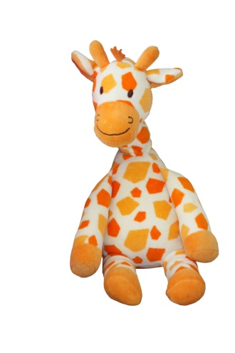
Share time
1 item per week
Please keep all shares school appropriate. Please do not send toys with weapons or inappropriate clothing.

Slide 15
Family Page
Help your child decorate a page to tell us a little bit about your family! (please take paper with you tonight)
Add photos of family, interests, pets, vacations, etc.
Please return completed page by September 10

Slide 16
Good to know
2 hour delays: Preschool starts at 10 am and ends at Noon
School & classroom websites
Funerals

Slide 17
Communication
Red folders
Notes from school will be sent home
Send notes to school (checked daily)
newsletters and calendars
Remind App
School/ class website (www.ncsweb.org)
E-mail: aasher@ncsmail.org
School Phone: 419-668-8480
Conferences and Progress Reports twice a year (fall & spring)

Slide 19
Thank You!!
Thank you for attending tonight.
Mrs. Rospert and I are looking forward to a great year!

